Slide 1
.NET Memory Leak Problems & Solution
Nguyễn Thanh Tùng

Slide 2

Table of Contents
.NET Framework Memory Management
CLR
Garbage collection
.NET Memory Leak Problems
What is memory leak?
Symptoms of memory leak
.NET Memory Leak Solutions
Finding memory leak
Solving memory leak

Slide 3

.NET Framework Memory Management

Slide 4
.NET Framework Architecture
C#
C++
VB.NET
J#
F#
JScript
Perl
Delphi
…
ASP.NET
Web Forms, MVC, AJAX
Mobile Internet Toolkit
Windows
Forms
WPF
Silverlight
WCF and WWF (Communication and Workflow Tier)
ADO.NET, LINQ and XML (Data Tier)
Base Class Library (BCL)
Common Language Runtime (CLR)
Operating System (OS)

Slide 5
CLR Common Language Runtime
The Heart of .NET Framework
CLR manages the execution of the.NET code
Manages the memory, concurrency, security, exceptions...
CLR

Slide 6
CLR Architecture
Base Class Library Support
Thread Support
COM Marshaler
Type Checker
Exception Manager
Security Engine
Debug Engine
IL to Native
JIT Compiler
Code
Manager
Garbage
Collector
Class Loader

Slide 7
What is Garbage collector
Automatic process collect memory used by unwanted objects (garbage)
Garbage - which are no longer referenced
Run on a separate thread at the back end
Run when there are no space in the managed heap to allocate new object

Slide 8
Object Roots /GC Roots/
Stack References
Static References /Fields, ThreadStatic/
Interop References /COM, API calls/
CPU Registers
Finalization Queue References

Slide 9
Stack & Heap
public void CaffeineCheck(int coffeesConsumed)
{
CaffeineAlert alert = new CaffeineAlert();
int coffeesRequired = 3;
if (coffeesConsumed < coffeesRequired)
{
alert.Announce("Send help.");
}
}

Slide 10
Stack Frame
For each thread
Alert()
CaffeineCheck (int coffeesRequired)
int coffeesRequired
int coffeesConsumed
.....
[Return address]
CaffeineCheck()
ParentMethod()

Slide 11
Value Types
Reference Types
eg:
byte
int
char
struct
...
Pointers
eg:
strings
classes
objects
arrays
Stack
Heap

Slide 12
CaffeineCheck(int coffeesRequired)
int coffeesRequired
int coffeesConsumed
CaffeineAlert alert
[Return address]
CaffeineAlert
Stack
Heap

Slide 13
Value Type
Reference Type
public class ValueTypeTest
{
public void ValueTypes()
{
int a = 1;
int b = a;
b = 2;
Console.WriteLine(a); // 1
}
}
public class ReferenceTypeTest
{
public void ReferenceTypes()
{
TestClass a = new TestClass();
a.Test = 1;
TestClass b = a;
b.Test = 2;
Console.WriteLine(a.Test); // 2
}
}
public class TestClass
{
public int Test;
}

Slide 14
public class CaffeineAlert
{
private List<Contact> Recipients;
}
public class Contact
{
private string Name;
private string Email;
}
string
Email
string
Name
Contact
list
string
Email
string
Name
CaffeineCheck(int coffeesRequired)
int coffeesRequired
int coffeesConsumed
CaffeineAlert alert
[Return address]
Contact
list
List<Contact>
Recipients
CaffeineAlert
alert
Stack
Heap

Slide 15
CaffeineAlert
alert
List<Contact>
Recipients
Contact
list
Contact
list
string
Name
string
Email
string
Name
string
Email

Slide 16
Object reference
Stack
Heap

Slide 17
Object reference
Stack
Heap

Slide 18
Object reference
Stack
Heap

Slide 19
Object reference
Stack
Heap

Slide 20
The Heap
Small Object Heap (SOH)
> 85KB
Large Object Heap (LOH)
Gen 2
Gen 1
Gen 0

Slide 21
Gen 0
Gen 1
Gen 2

Slide 22
Gen 0
Gen 1
Gen 2

Slide 23
Gen 0
Gen 1
Gen 2

Slide 24
.NET Memory Leak Problems

Slide 25
What is memory leak?
“In computer science, a memory leak is a particular type of unintentional memory consumption by a computer program where the program fails to release memory that it no longer needs.”
The GC recovers only memory that has become unreachable.
It does not free memory that is still reachable.
In .NET, this means that objects reachable by at least one reference won't be released by the GC.

Slide 26
Memory leak is nightmare?
A drop of water is not a big issue. But drop by drop, a leak can become a major problem.
In computing, even a little leak can bring down the system if it occurs many times.

Slide 27
Symptoms of memory leak

Slide 28
.NET Memory Leak Solutions

Slide 29




Finding memory leak
2013

Slide 30
Visual Studio 2013
High level

Slide 31
ANTS Memory Profiler
More in depth

Slide 32
DotTrace Memory
More in depth

Slide 33
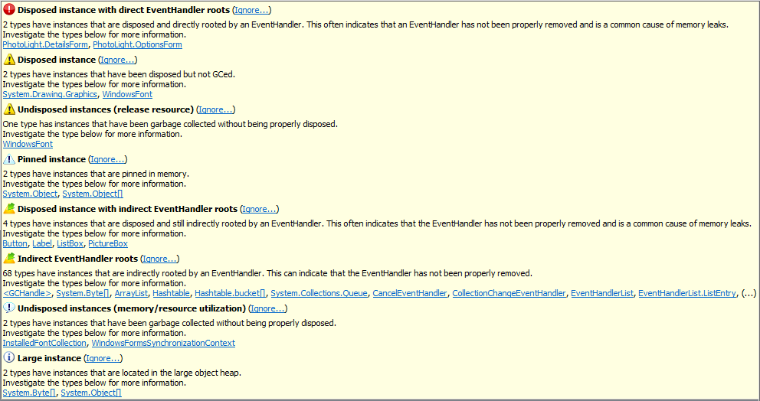
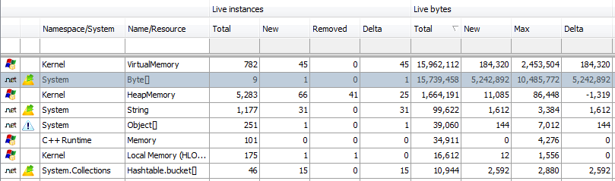
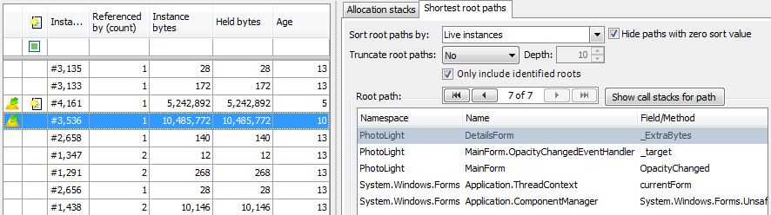
Memory Profiler
More in depth

Slide 34

WinDbg
For explorers and ninjas
Native/managed and « graphical » debugger
Free
Lightweight installation
Can attach to a process or explore a memory dump
Ideal to dive into the internals of a process

Slide 35
WinDbg extensions
Sos.dll for inspecting managed memory
!DumpHeap for listing objects from the heap
!DumpObj (do)
!GCRoot finds the root object for a given object

Slide 36
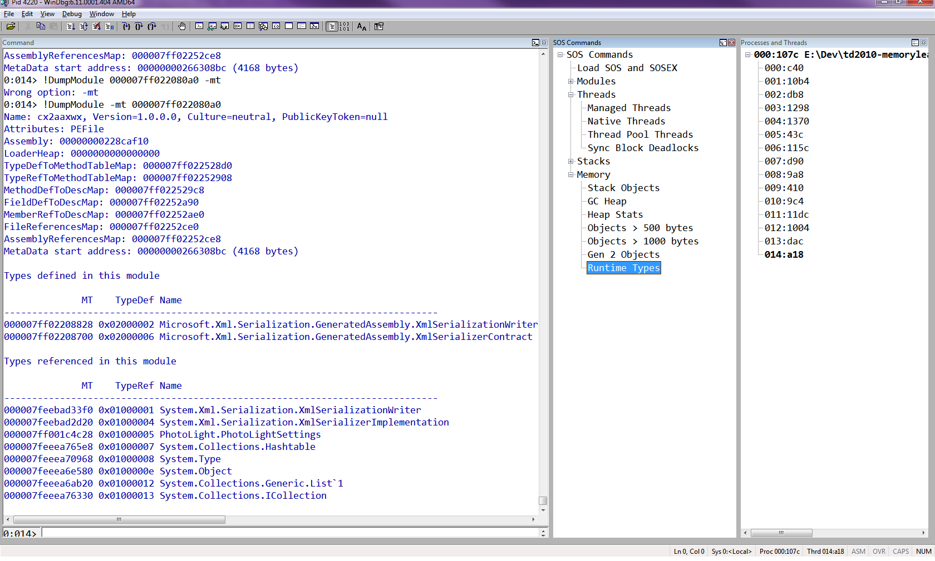
WinDbg

Slide 37
Some common leak & solution
Static event
MainForm
OptionsForm
DetailsForm

Slide 38

Some common leak & solution
Lapsed listener (missing unsubscription)
MainForm
OpacityChanged
OptionsForm
DetailsForm

Slide 39

Some common leak & solution
Dispose method not invoked
Incomplete Dispose method

Slide 40

Prevention is better than cure
Control objects ownership
Static analysis
Above all a good knowledge of your code
Each += (or AddHandler) is a potential enemy!
use -= !
using and Dispose
Or simply restart the app…

Slide 41
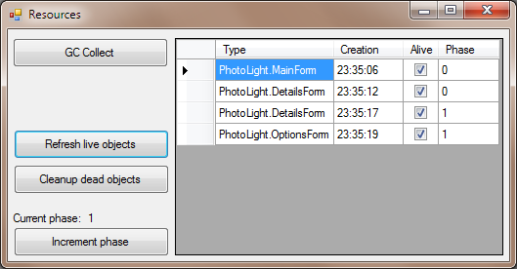
Prevention is better than cure
Custom tooling – Here a built-in monitoring screen

Slide 42

Resources
Article How to detect and avoid memory and resources leaks in .NET applications
http://msdn.microsoft.com/en-us/library/ee658248.aspx
Book Advanced .NET Debugging Mario Hewardt, also author of Advanced Windows Debugging
Book Debugging Microsoft .NET 2.0 Applications John Robbins
Tess Ferrandez’ blog, ASP.NET Escalation Engineer at Microsoft http://blogs.msdn.com/tess/archive/tags/Memory+issues/default.aspx
Detecting event handlers leaks with WinDbg http://is.gd/79Qlk (David Anson’s blog, MS)

Slide 43
Q&A?

